Slide 1


INSTITUTE: CHANDIGARH UNIVERSITY
DEPARTMENT: UIC
MCA
SOFTWARE TESTING
24CAH-654
DISCOVER . LEARN . EMPOWER

Slide 2

SOFTWARE TESTING
Unit -3
Test Management using JIRA

Slide 3
Jira Dashboards
Jira Dashboards are customizable, interactive, and visual displays that provide a real-time overview of key performance indicators (KPIs) and important information related to a project or team. Dashboards in Jira help teams and stakeholders monitor progress, track metrics, and make informed decisions. Users can create multiple dashboards tailored to specific needs and share them with team members.
Key Components of Jira Dashboards:
Gadgets:
Gadgets are the building blocks of Jira Dashboards. They are small, specialized tools that display specific types of information. Examples include filters, charts, statistics, and activity streams.

Slide 4
Filter Results:
Dashboards often include gadgets that display the results of predefined filters. Filters are queries written in Jira Query Language (JQL) to retrieve specific sets of issues.
Charts and Graphs:
Gadgets like pie charts, bar charts, and line charts visually represent data, providing insights into project progress, issue distribution, and other metrics.
Agile Gadgets:
For teams using Agile methodologies, Jira Dashboards can include gadgets specifically designed for Agile boards, sprints, and burndown charts.
Activity Streams:
Gadgets displaying activity streams show recent updates, comments, and changes related to the issues in the project.
Filter Results:
Dashboards often include gadgets that display the results of predefined filters. Filters are queries written in Jira Query Language (JQL) to retrieve specific sets of issues.

Slide 5
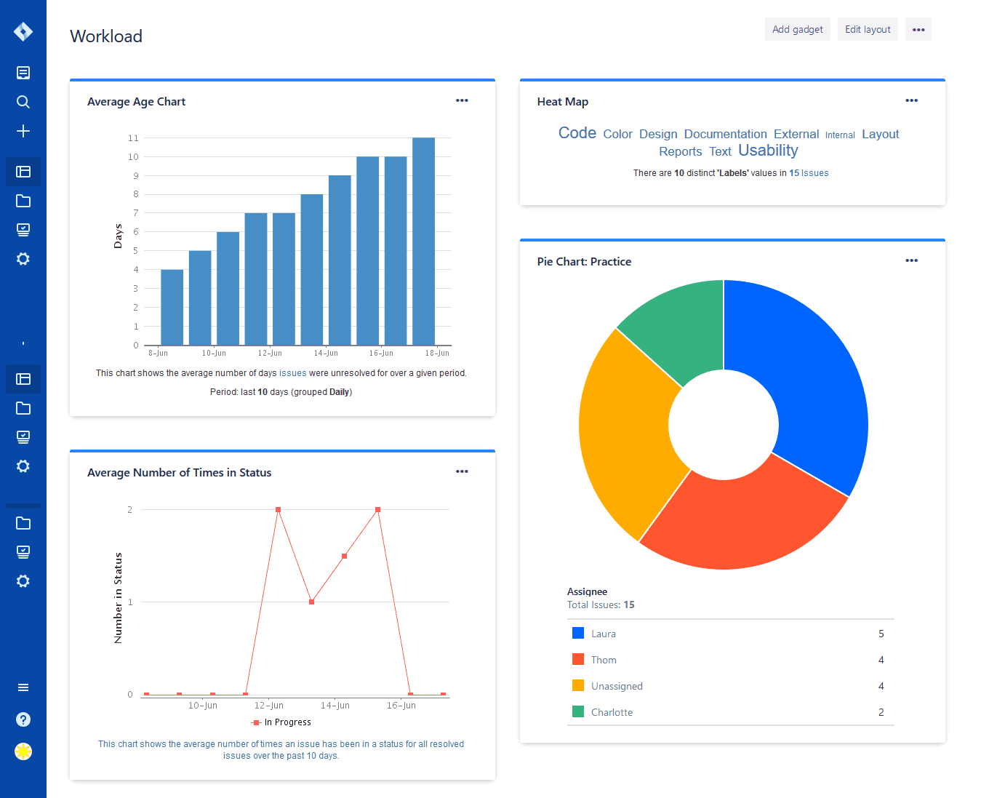

Slide 6
Creating and Customizing Dashboards:
Create a Dashboard:
Users can create a new dashboard by navigating to the "Dashboards" menu and selecting "Create Dashboard."
Add Gadgets:
Once a dashboard is created, users can add gadgets by selecting "Add Gadget" and choosing from a variety of available gadgets.
Configure Gadgets:
Gadgets can be configured to display specific information based on filters, projects, or other criteria. Users can customize the display options for each gadget.
Share Dashboards:
Dashboards can be shared with other users or groups, allowing for collaborative monitoring and reporting.
Arrange Gadgets:
Users can arrange gadgets on the dashboard to create a visually appealing layout. Gadgets can be rearranged, resized, and configured to suit individual preferences.
Create Multiple Dashboards:
Users can create multiple dashboards for different purposes, such as project tracking, team performance, or executive summaries.

Slide 7
Common Types of Dashboards:
Project Overview:
Provides a high-level view of a project, including key metrics, progress, and issues.
Agile Sprint Dashboard:
Focuses on Agile development, displaying information about sprints, burndown charts, and team velocity.
Service Desk Dashboard:
Designed for service management teams, offering insights into service requests, incident resolution, and customer satisfaction.
Team Performance Dashboard:
Tracks team performance metrics, such as issue resolution time, workload distribution, and sprint progress.
Executive Summary:
Summarizes key project metrics for stakeholders and executives, providing a quick overview of project health.

Slide 8
Different methods for creating issue
In Jira, creating issues is a fundamental action that allows users to capture, track, and manage work items, tasks, or other units of work within a project. There are multiple methods for creating issues in Jira, each suited to different use cases and preferences:
1. Create Button:
Location: On the Jira dashboard or within a specific project.
Steps:
Navigate to the desired project or the Jira dashboard.
Click on the "Create" button.
Select the appropriate issue type (e.g., Story, Bug, Task).
Fill in the required fields and any additional information.
Click "Create" to save the new issue.

Slide 9
2. Quick Add (Global Shortcut):
Location: Available from anywhere in Jira using the quick add global shortcut.
Steps:
Press the period (.) key to open the quick add menu.
Type a summary for the issue.
Press Enter to create the issue.
3. Issue Navigator:
Location: From the Issue Navigator or Search Results.
Steps:
Perform a JQL search or navigate to the Issue Navigator.
Click on "Create Issue" to create a new issue with default values.
Alternatively, use the "Bulk Change" option to create multiple issues at once based on search criteria.

Slide 10
4. Jira Software Boards (Agile Boards):
Location: Within an Agile board (Scrum or Kanban).
Steps:
Open the Agile board associated with the project.
Use the "Create" button on the board to create new issues directly.
5. Email Requests:
Location: Can be configured through Jira Service Management.
Steps:
Set up an email address for Jira Service Management.
Users can send emails to the configured address to create issues, and the content will be automatically converted into issues.

Slide 11
6. CSV Import:
Location: In Jira, through the CSV import option.
Steps:
Prepare a CSV file containing the data for the new issues.
Use the Jira import wizard to map the fields and import the issues.
7. Clone or Copy Issues:
Location: On an existing issue.
Steps:
Open an existing issue.
Use the "More" dropdown and select "Clone" or "Copy" to create a new issue with similar details.

Slide 12
THANK YOU

